Slide 1
Side-Channel Analysis Hardware Hacking from a Distance
Ben Janis
July 20, 2022

Slide 2


Solving problems for a safer world
© 2020 MITRE #20-2238 8-31-2020
Notes:
Thank you for joining us today! We are excited to share with you WHO MITRE is and WHAT we do. We’re going to start off together here in the main room to learn the basics of MITRE and then we’ll head into some breakout rooms to hear about some of the cool work being done at MITRE directly from our engineers!
Without further ado, let’s dive in!
At MITRE, we’re a company of more than 8,000 innovators, deep thinkers, conveners, and problem solvers who come to work every day to tackle the complex threats facing our nation and the world.
With crises and world events unfolding in ways that nobody expects, we pivot quickly, and proactively lead in the public interest.
We know we must pioneer for a better future.

Slide 3

Mission: mitre's mission-driven teams are dedicated to solving problems FOR A SAFER WORLD
Notes:
Through our public-private partnerships and federally funded R&D centers, MITRE works across government and in partnership with industry to tackle challenges to the safety, stability, and well-being of our nation.
We solve tough problems that industry can’t or won’t work on because there isn’t a profit motive or realistic way to get consensus on a solution. We don’t operate with commercial interest. We work in the public interest.
Like developing and supporting the freely available MITRE ATT&CK framework that helps slow down cyber adversaries by exposing the tactics and techniques they use to infiltrate networks.

Slide 4

Our Impact: Aerospace & Transportation: Airline Traffic Collision Avoidance, Cybersecurity: Threat-informed Defense, Health & Human Services: Data Standards & Interoperability, Homeland Security: Protecting our borders, National Security: GPS/PNT; reliability, accuracy, resiliency, Technology & Innovation: Prototypes & Demonstration
4
Notes:
In today's complex world, there will always be a need for more evolution, more creativity, more innovation.
We strengthen the systems that protect our way of life in so many important areas.
Our world is complex. Maybe you didn’t know that MITRE’s innovations power todays GPS systems. Or that we pioneered air traffic collision avoidance systems. Or that we are working to unlock the power of electronic health records to improve patient treatment outcomes.

Slide 5

MITRE touches your life Every day
Notes:
For all of us, the world is a safer place because MITRE exists.

Slide 6
What is a Side-Channel?

Slide 7




Side-Channel Example: Store Backroom
By only asking employees for items in the
back and without going in yourself, figure out:
How is the backroom organized?
Where are different items located?
What shelves are items stored on?
How many items per bulk box?
Employees Only

Slide 8
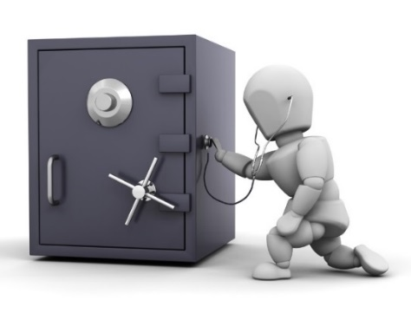
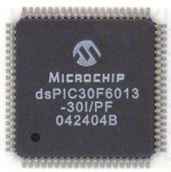
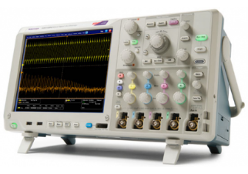
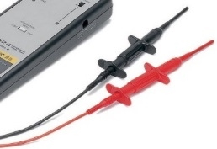
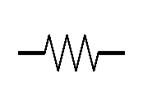

Side-Channel Analogy
Combo
Crypto Keys
Acoustic Side-Channel
Power Side-Channel
Side-channel analysis (SCA) leverage unavoidable side-effects of performing computation

Slide 9
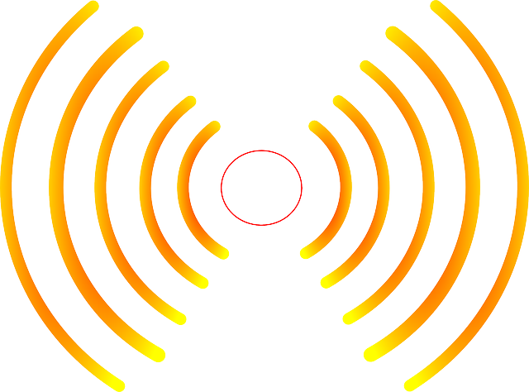

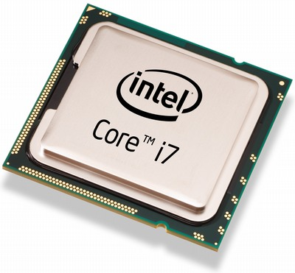

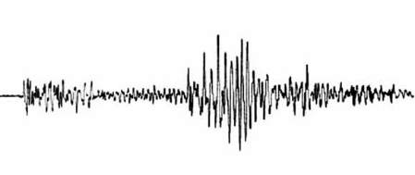
Side-Channel Attacks
SCA commonly used to:
Reverse engineer system operation
Extract information (e.g., keys)
Monitor and validate system behavior
EM Radiation
Thermal
Execution Time
Instantaneous Power
http://www.itp.net/573498-intel-core-i7-920
https://www.kisspng.com/png-light-electromagnetic-spectrum-electromagnetic-rad-1233022/
Acoustic Vibrations
https://pixabay.com/en/thermometer-temperature-rainbow-305319/
https://commons.wikimedia.org/wiki/File:Dtjohnnymonkey-Stopwatch-no-shading.svg
https://commons.wikimedia.org/wiki/File:1989_Loma_Prieta_earthquake_seismogram.jpg

Slide 10
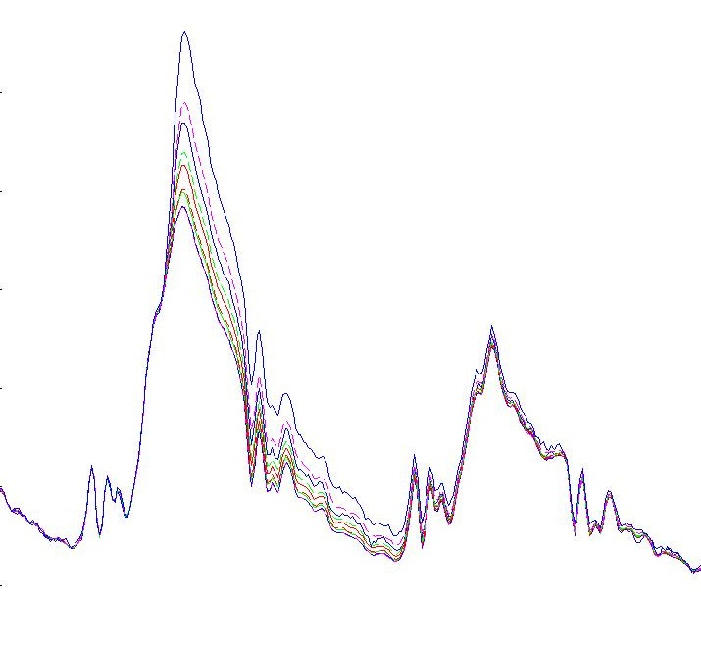
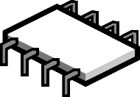
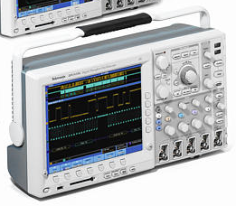


Side-Channel Capture
Side-channel leakage is captured during normal device operation
Target device is instrumented with sensors (e.g., current monitor)
Device commanded to perform its sensitive operation
Captured side-channel data is stored along with the corresponding inputs and outputs
Data-dependent power consumption
Data
Power Consumption
Photo: Tektronix Inc.
Time
Chip Image Source: https://pixabay.com/en/microchip-component-computer-chip-309407/
Battery Image Source: Tango Desktop Project
© 2018 MITRE Corporation

Slide 11



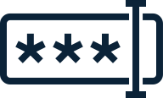
Side-Channel Workshop: PIN Lock
Scenario:
A door is secured by a smart door lock
We want to figure out the 4-digit PIN to open it
Data available to us:
Success / failure of PIN guess
Power consumption of the lock device
Knowledge that the lock uses strcmp

Slide 12


Side-Channel Workshop: strcmp
strcmp(correct_pin, incorrect_pin)
1 2 3 4
Correct PIN:
>
1 1 1 1
Pin Guess:

Slide 13
Side-Channel Workshop: strcmp
strcmp(correct_pin, incorrect_pin)
1 2 3 4
Correct PIN:
<
1 3 1 1
Pin Guess:
How could we exploit this?

Slide 14
Side-Channel Workshop
https://mybinder.org/v2/gh/janisbent/sc-lab/v3.0?filepath=lab.ipynb
https://bit.ly/3ogwoQn

Slide 15
Ben Janis
btjanis@mitre.org
linkedin.com/in/benjanis

